Slide 1
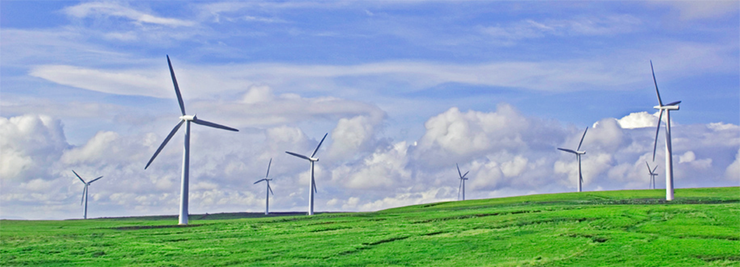
Electricity Distribution Business – Investment in Wind Generation Wind Association of New Zealand 1 July 2015

Slide 2
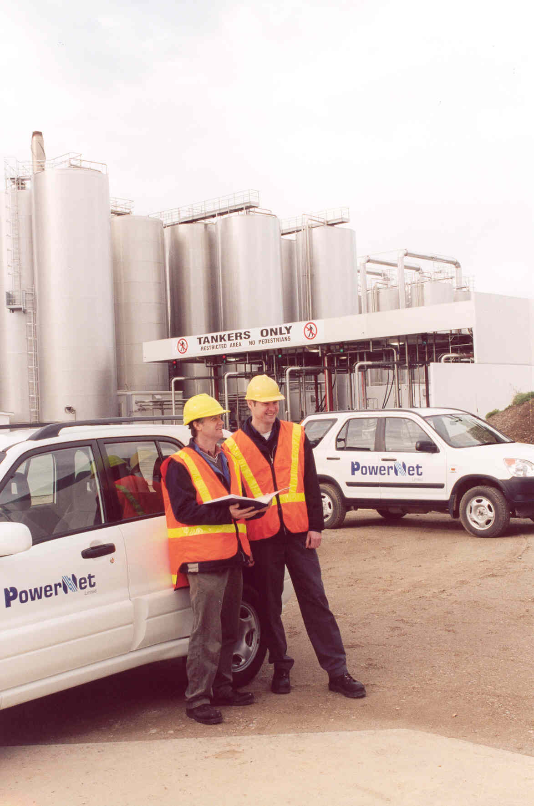
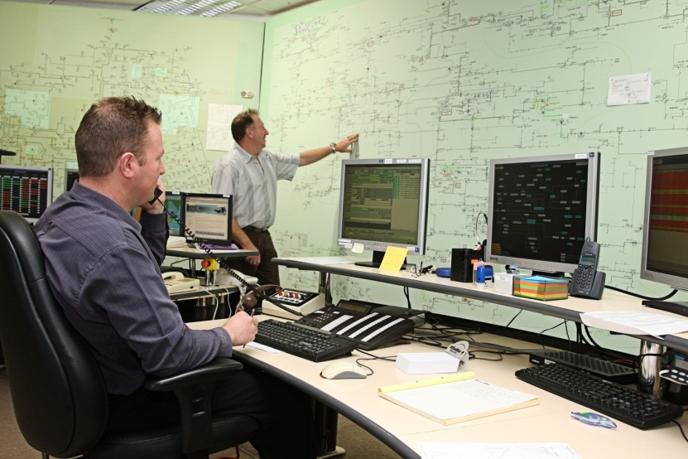
Network Management Company
50% Electricity Invercargill Limited
50% The Power Company Limited
Manage five electricity networks
The Power Company
Electricity Invercargill
OtagoNet
Electricity Southland
SIESA
150 Employees, 110 Contractors
Managed Turnover $122 Million pa (+$74 capital)
Managed Asset Value $711 Million pa
Managed networks;
Physical Network Size 3rd Regulatory Asset Value 6th Customer Numbers 8th

Slide 3
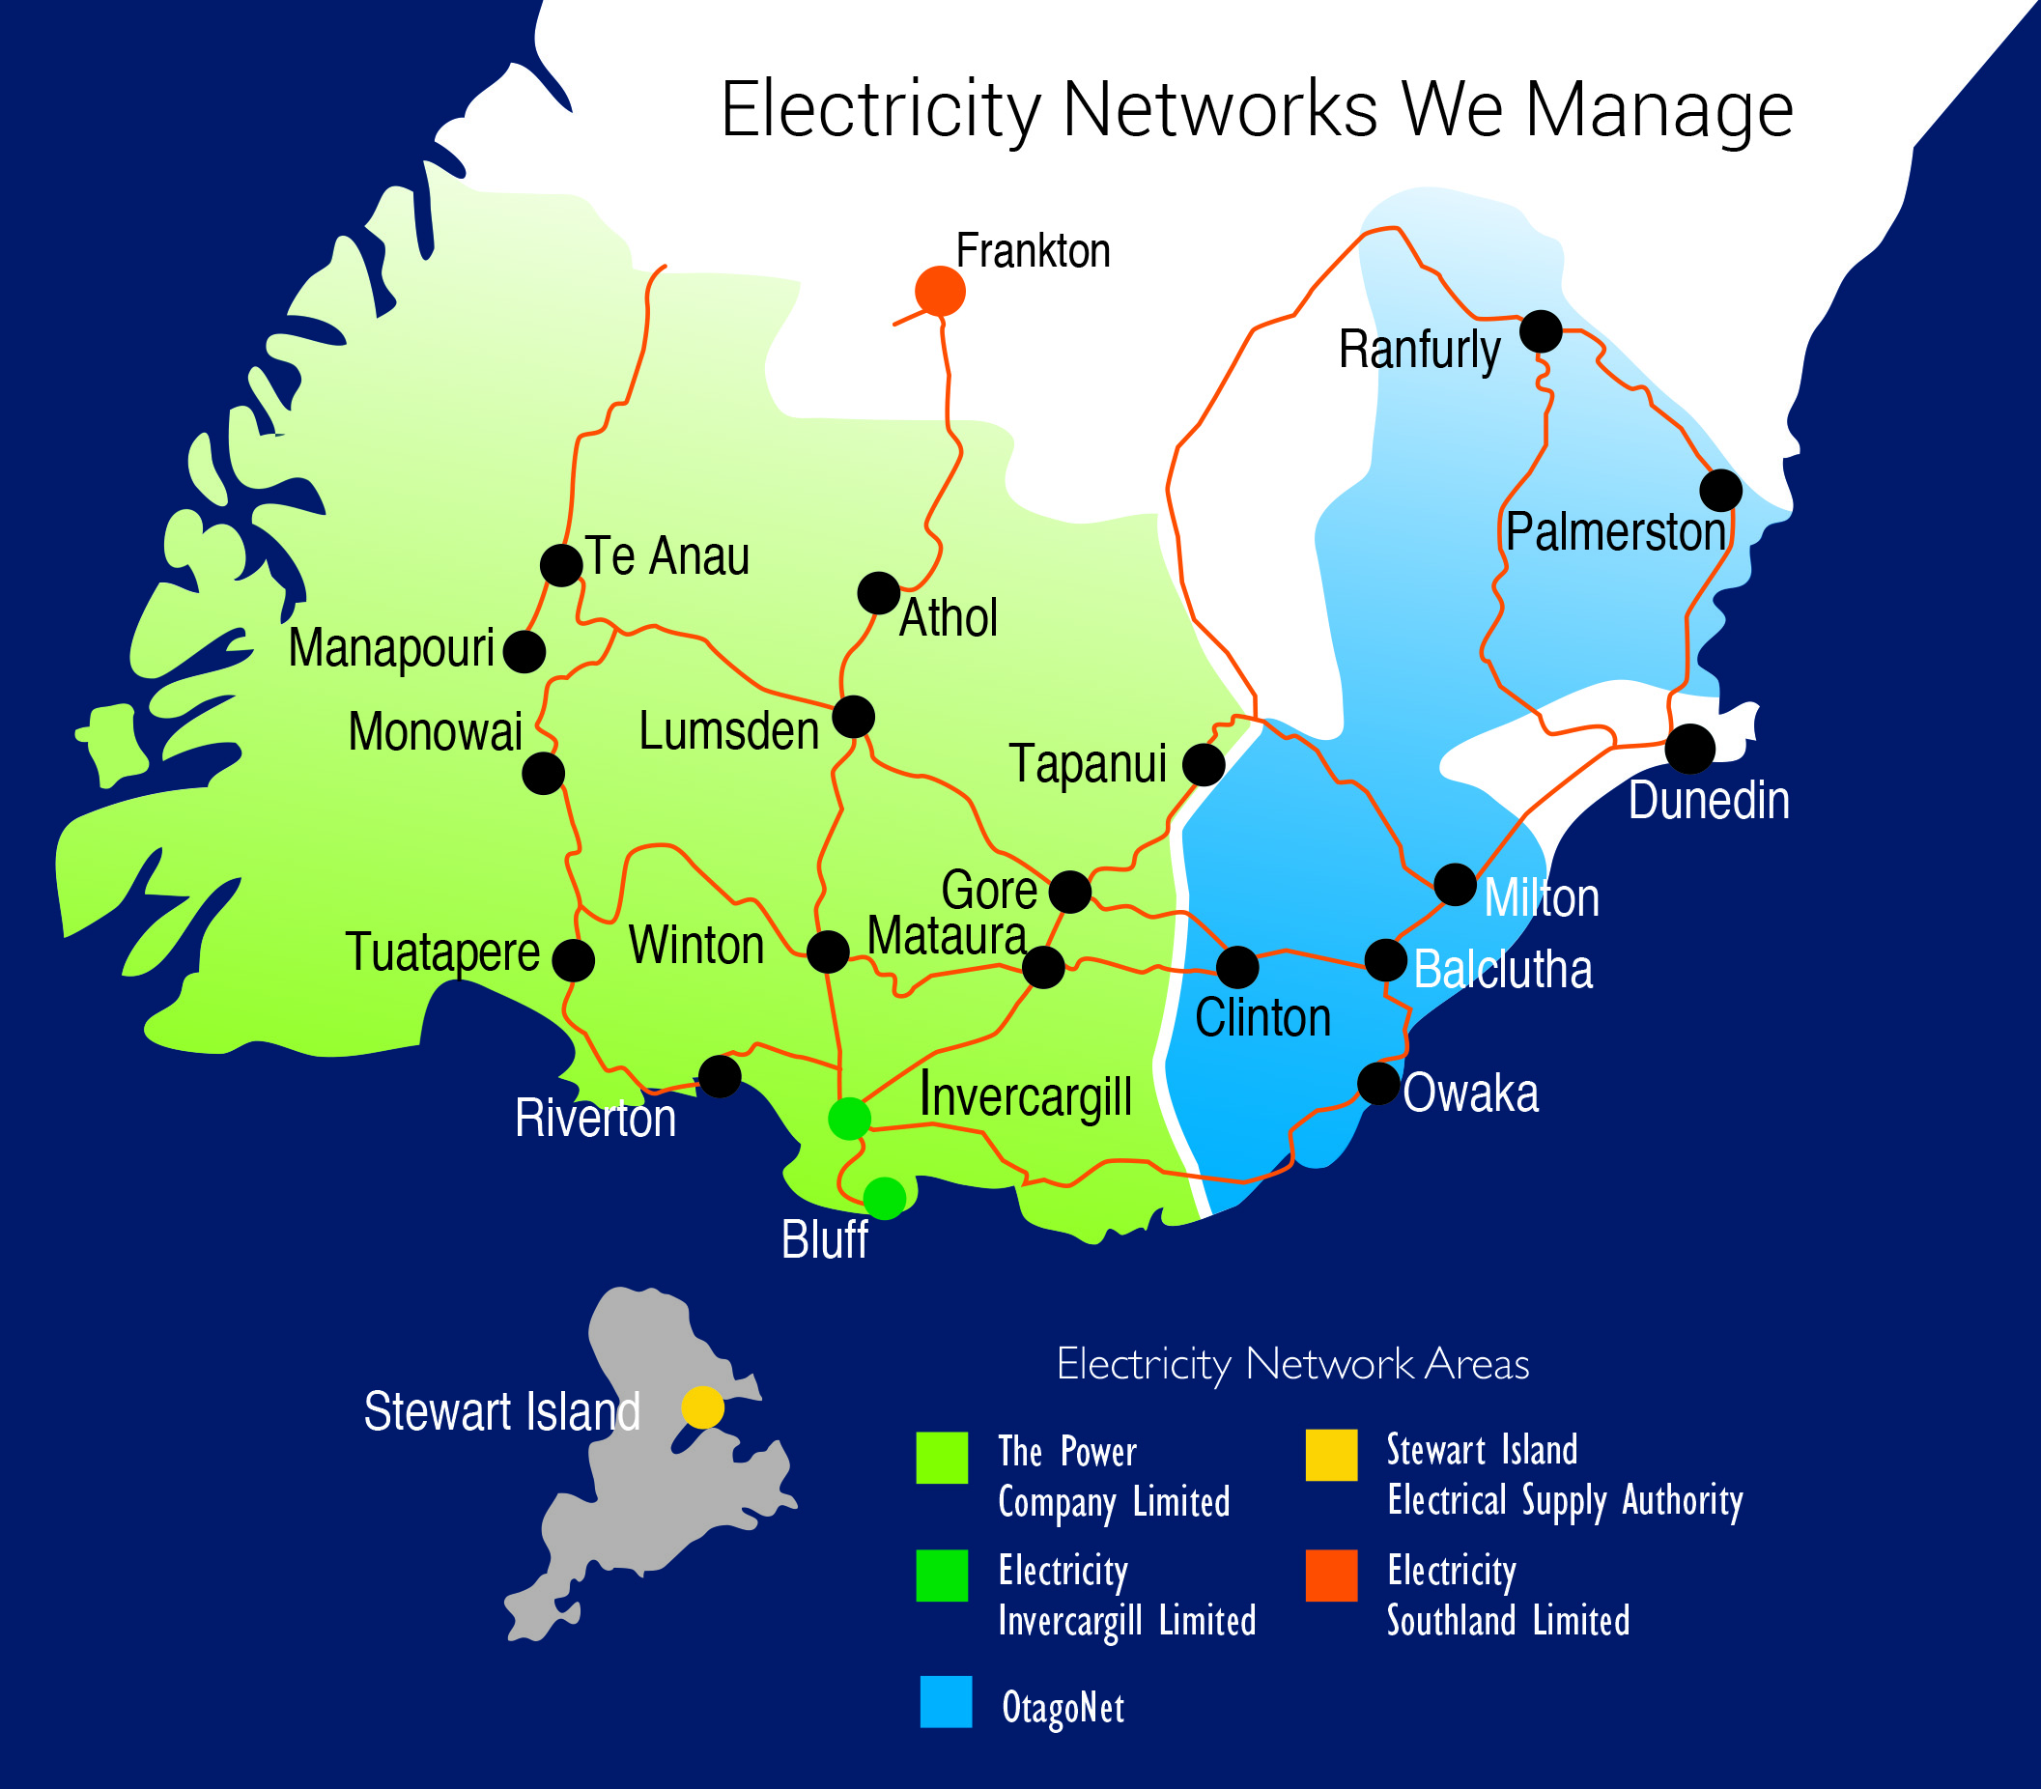
PowerNet Overview
Aggregation of lower South Island electricity networks for >20 years
Three main networks, and two smaller, managed by one company
Scale benefits to shareholders and customers

Slide 4
Southern Generation Overview
Southern Generation Limited Partnership
Wind generation investment in Southland & Otago
SGLP managed by Pioneer Generation
EIL & TPC jointly own 50% of SGLP, through Roaring Forties Energy
Pioneer own the remaining 50%
Value of SGLP is >$30 M
Return on Investment for Roaring Forties ~9%
Southern Generation
Roaring Forties Energy (50%)
Electricity Invercargill (Pylon) (50%)
The Power Company (Last Tango) 50%)
Pioneer Generation (50%)

Slide 5
Southern Generation Overview
Mount Stuart wind farm near Balclutha (commissioned 2012)
Flat Hill wind farm near Bluff (to be commissioned July 2015)
Five wind development sites across Southland and Otago
Jerico (near Blackmount)
Landslip Road (near Tapanui)
Blue Mountains (near Tapanui)
Waikaka (Eastern Southland)
Omaui (near Bluff & Flat Hill)
Generation output assumed at 47 GWh pa
Mount Stuart 22 GWh pa
Flat Hill 25 GWh pa
Output equivalent to 5,000 to 6,000 residential homes
Small scale – approx 0.1% of NZ annual generation

Slide 6
Why diversify into distributed generation……
Multiple Reasons;
Opportunity for non-regulated return
Forecast higher returns than regulated network returns… with higher risks
Been there before
TPCL ownership of Monawai Power Station – Bradford reforms required divestment
PowerNet wind testing (1990’s) of Flat Hill and White Hill. Bradford reforms required divestment
PowerNet gas exploration (CSM) in 1990’s in Western Southland, may have led to generation
Shareholder balance sheet strength
EIL and TPCL were carrying little debt
Opportunity to use balance sheet to achieve shareholder returns above WACC

Slide 7
Why diversify into distributed generation……
Multiple Reasons;
Geographical proximity
Mount Stuart and Flat Hill both within Shareholder networks;
Mount Stuart – OtagoNet network (75.1% TPCL, 24.9% EIL)
Flat Hill – TPCL network, connected to Bluff substation. Feeds Bluff township (EIL network)
All five development sites within shareholder networks
Opportunity to invest in Renewable Generation
Wind very much accepted new generation form
Pioneer Generation – proven wind farm developer & operator
Been through the learnings
Flat Hill – development risks managed, transfers to JV at commissioning
Management and Shareholder comfort

Slide 8
Challenges to overcome……
Due Diligence
Engaged Aurecon & Energy Link
EIL & TPCL due diligence of Pioneer Generation
Development Risks
Pioneer Generation – proven developer
Flat Hill transfers to Southern Generation upon commissioning
Shareholder Approvals
Two shareholders with differing delegated authorities
Ability to meet new JV partner timeframe – aligning to their investment decisions

Slide 9
Challenges to overcome……
Other Acquisitions
OtagoNet network full ownership by TPCL and EIL
Value of transaction about 10 times the wind investment
At times, can not control the timing of the business development opportunity pipeline!
Investment Vehicles…. some complexity
Limited Partnership Structure between;
Pioneer Generation and EIL/TPCL… and
EIL and TPCL themselves
For EIL & TPCL, two limited partnership structures in place (double the complexity)
However, structured to take advantage of future opportunities

Slide 10
Summary
Lower South Island network and generation companies having aligned business drivers
Opportunity to diversify within energy sector
De-risked opportunity – partnering with proven operator
Electricity networks’ balance sheet utilised to realise new renewable generation opportunities
Structured so the partnership can grow as opportunities present themselves
Strategic positioning for the future

Slide 11
Questions?

